Slide 1
PROJECT TITLE: Capstone Project Management & Review System
CSE7101- Capstone Project
Review-1
Batch Number:CIT_29
Under the Supervision of,
Dr. Sampath A.K.
Professor
School of Computer Science and Engineering
Presidency University
Roll Number | Student Name
Manideep Chilukuri | 20221CIT0091
Harshith R | 20221CIT0107
S Neha Shree | 20221CIT0083
Name of the Program: B.Tech(Computer Science and Engineering)(IOT)
Name of the HoD: Dr. Anandraj S.p
Name of the Program Project Coordinator: Dr.Sharmasth Vali
Name of the School Project Coordinators: Dr. Sampath A K , Dr. Geetha A

Slide 2
Problem Statement
Colleges face challenges in managing capstone projects:
Manual guide & reviewer assignment.
Lack of centralized project title allocation.
Poor communication between students, guides, and reviewers.
No structured review scheduling and feedback mechanism.
Need: A role-based system to automate assignments, streamline collaboration, and ensure transparency in project evaluation.

Slide 3
Objectives
Automate student–guide–reviewer assignments from uploaded JSON data.
Allow students to form groups, select project titles, and upload documents.
Provide dashboards for each role (Admin, Student, Guide, Reviewer).
Enable reviewers to set availability slots and manage reviews.
Support feedback, scoring, and progress tracking.
Generate analytics & evaluation reports for admin.

Slide 4
Analysis of Problem Statement
Existing Systems: Generic tools like Moodle, Trello, or MS Teams exist but lack capstone-specific workflows.
Gap: No dedicated platform for automatic guide/reviewer assignment, student group management, and structured review cycles.
Solution: A custom web application designed specifically for academic project workflows.

Slide 5
Technology Stack Components:
Frontend: React.js, HTML5, CSS3, Tailwind CSS
Backend: Python
Database: Firebase
Authentication: Firebase Auth (Role-based login)
File Storage: Firebase Storage
Notifications: Email

Slide 6
Github Link
Github Link : Capstone-Project-Management-Review-System
available files : ppt .

Slide 7
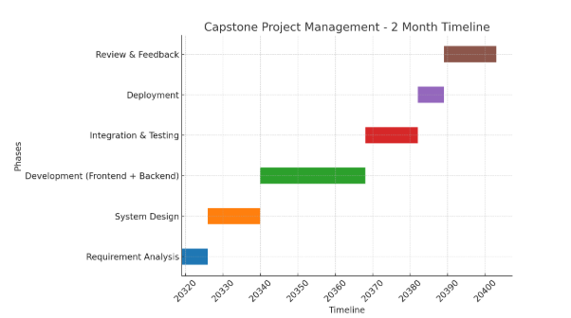
Timeline of the Project (Gantt Chart)

Slide 8


